Slide 1
How to create a github repo
For dummies

Slide 2
Step 1: Login to GitHub

Slide 3
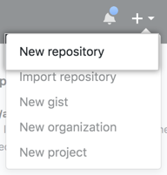
Step 2: Click on New repository

Slide 4
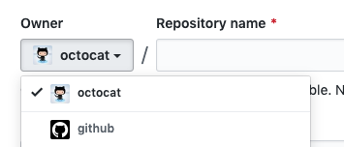
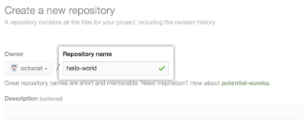
Step 3: Fill out the form

Slide 5
Step 4: You did it
yes

